Slide 1
PREDICTIVE ANALYSIS OF CRIME LOCATIONS IN LOS ANGELES
Shashidhar Manoharan and Geslande Belus
Project Presentation: Phase 2
Presented by Team F
Team’s Github Page Link

Slide 2


AGENDA
GitHub Repository
Project and Dataset Overview
Dataset Details
Literature Survey
Exploratory Data Analysis (EDA)
Data Preparation
Model Construction
Model Evaluation
Summary
References
Notes:
Geslande: "Let's look at what we'll discuss today, starting with our research question, followed by an introduction to our dataset, and moving through our analytical methods to our future plans."

Slide 3
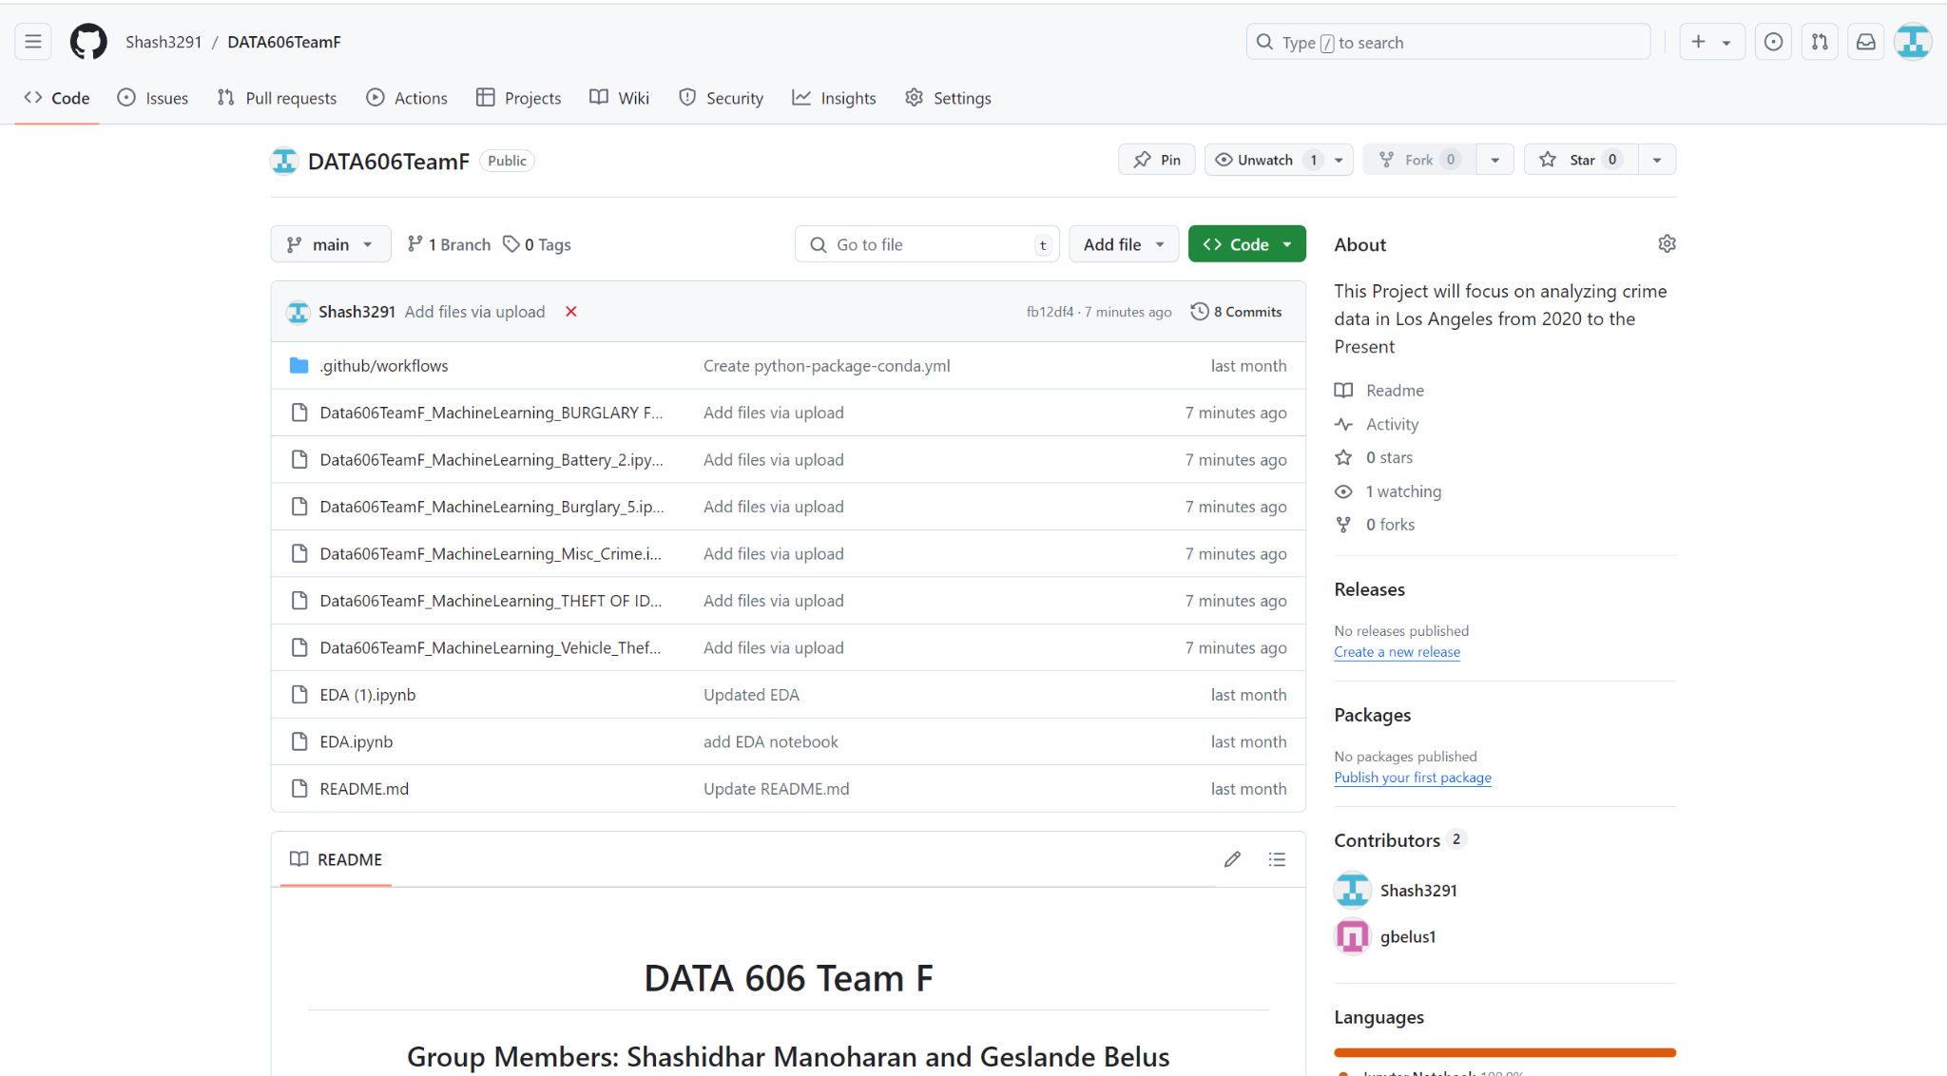
Github Page Screenshot

Slide 4
Project Overview
About
Why this Project?
Research Question/Hypothesis
Aim to utilize historical crime data from 2020 till the present in Los Angeles in order to predict potential crime hotspots for different crimes in the city.
Aim to utilize various features in the dataset such as date occurred, time occurred, victim age, victim sex and more in order to make these predictions
Aim to use machine learning regression algorithms to accomplish this task
Crime is something we want to cut down in the world as much as possible
If we have the ability to understand where certain crimes are located, we can adequately distribute necessary resources to those areas to tackle that specific crime.
This project can be used as a resource in this resource allocation process
Research Question: Can machine learning regression algorithms accurately predict the latitude and longitude locations of different types of crimes in Los Angeles using data from 2020 to the present?
Hypothesis: By analyzing crime data from 2020 to the present, machine learning regression algorithms can effectively predict the specific latitude and longitude of future crimes in Los Angeles sorted by crime

Slide 5

DATASET INTRODUCTION
Los Angeles Crime Data from 2020 to 2024: LINK
947,776 crime records total
26 total features
2 target variables (latitude and longitude)
Will be creating a regression model for prediction
Plan to test linear regression, polynomial regression, decision tree, random forest, and neural networks
Notes:
NOTE: dataset, i.e. describe the dataset and what kind of machine learning (ML) or data analyses (DA) will you do on it (prediction?classification?clustering?) Provide a link to the dataset, a clear description i.e. clear info on data size, #instances/#samples, #raw attributes, #features you can most likely select/extract/use, will you do a classification or prediction, if it is a classification how many categories, i.e. number of categories, what are the categories etc.).
Speaker: “Through the use of machine learning models, our objective is to forecast the locations of criminal acts in Los Angeles by taking into account a number of influential factors, including the time, date, and demographics of the victims.”

Slide 6
Similar Approaches Refresher
Some people have uploaded this dataset to Kaggle
Almost entirely just EDA
Random Forest/Logistic Regression models used in one example (predicting whether case would be solved)
Saw a Plotly interactive map that we definitely want to try and adjust towards our own project
Research Paper in Denmark on figuring out the route’s criminals took from their house to the places of crime in order to determine what “routes” are causing people to commit crimes the most
Concept doesn’t make much sense, drawing a line from someone's house to the location of the crime
Research Paper of someone trying to predict everything about a crime (place, time, type)
Only in theory, no actual code
Doe, J., & Smith, B. (2012). Crime prediction using machine learning algorithms. Proceedings of the IEEE International Conference on Data Mining, 210-215. https://doi.org/10.1109/ICDM.2012.6298814
GusLovesMath. (2020). Los Angeles Crime Data Quick EDA. Kaggle. https://www.kaggle.com/code/guslovesmath/los-angeles-crime-data-quick-eda
Notes:
NOTE: what is the state of the art? what’s missing?

Slide 7
Similar Approaches (cont.)
Prediction of crime rate in urban neighborhoods based on machine learning is another similar study that provides insights, advancements and challenges in using machine learning for geographic location prediction.
Summary: This study used Generative Adversarial Networks (GANs) to forecast crime distribution across city layouts using over two million Philadelphia crime data points from 2006 to 2018.
State of the Art
Multi-output Regression
Deep Learning Applications
Generative Models
Current Gaps and Challenges
Data Integration Complexity
Scalability and Real-time Processing
Computational Efficiency
Adaptive Learning Models
He, J., & Zheng, H. (2021). Prediction of crime rate in urban neighborhoods based on machine learning. Engineering Applications of Artificial Intelligence, 106(104460). https://doi.org/10.1016/j.engappai.2021.104460
Notes:
Summary:
This research uses Generative Adversarial Networks (GANs) to forecast crime distribution across city layouts using over two million Philadelphia crime data points from 2006 to 2018. The algorithm generates crime hotspot maps for urban planning and security by training using thousands of one-to-one city floor plan and crime data pictures. The model accurately forecasts crime concentration locations, allowing planners to change city designs and perhaps lower crime rates with approaches that may be extended to other urban features.
Modern Improvements
Machine learning is improving latitude and longitude prediction. Multi-output regression models increase prediction accuracy and reliability by correlating numerous outputs. LSMs and Convolutional Neural Networks have also helped. Models that grasp complex spatial and temporal patterns are vital for urban planning, environmental monitoring, and public safety.
Generative models, notably GANs, are changing how we simulate and predict urban crime and city planning. These models' very precise geographic data simulations allow urban planners and scholars to imagine future changes and their impacts without testing.
Presently Challenged
We encounter obstacles. Spatial autocorrelation complicates many machine learning models. To create useful datasets from various data sources, thorough preparation and data fusion are needed.
Scalability and real-time processing are challenges. As cities develop and data volumes rise, our algorithms must scale to give real-time traffic management and crime mapping insights.
Model generalization is difficult. How can we ensure a model trained in one location works in another? This unanswered question is fundamental to universal replies

Slide 8
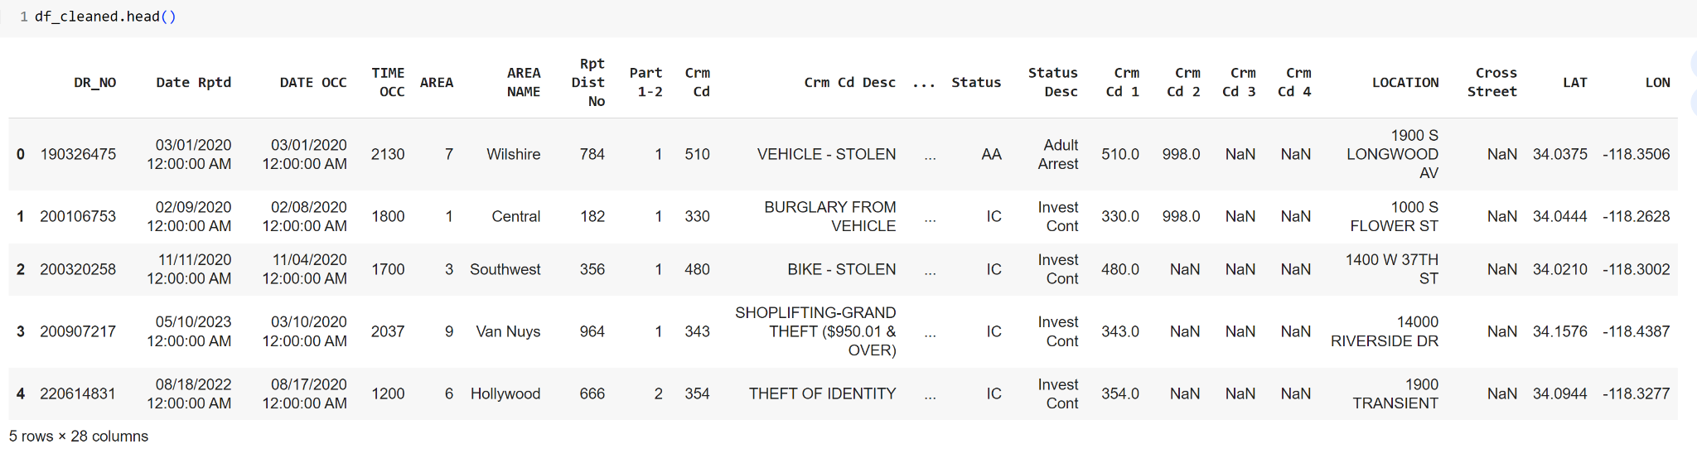
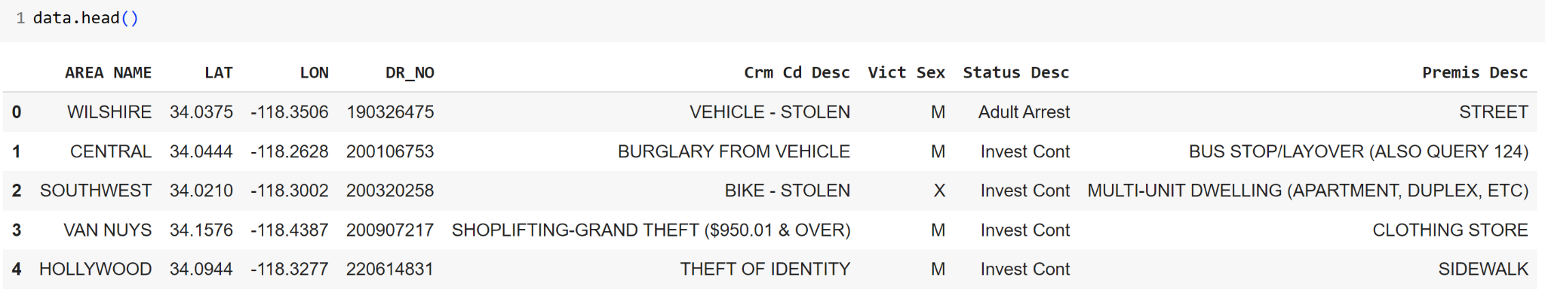
DATA PREP

Slide 9
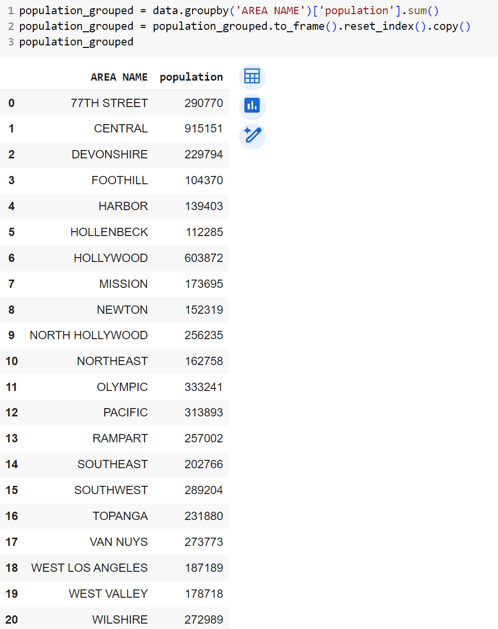
Population Count by Area Name

Slide 10
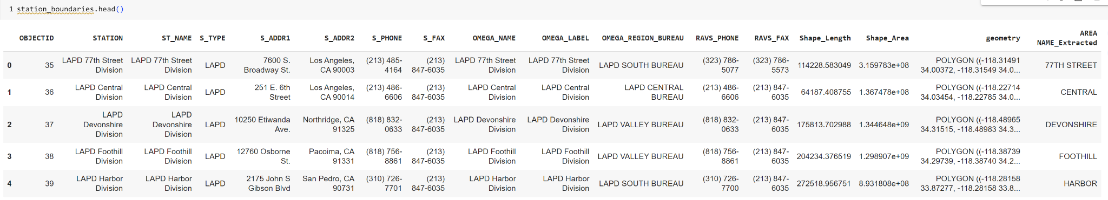
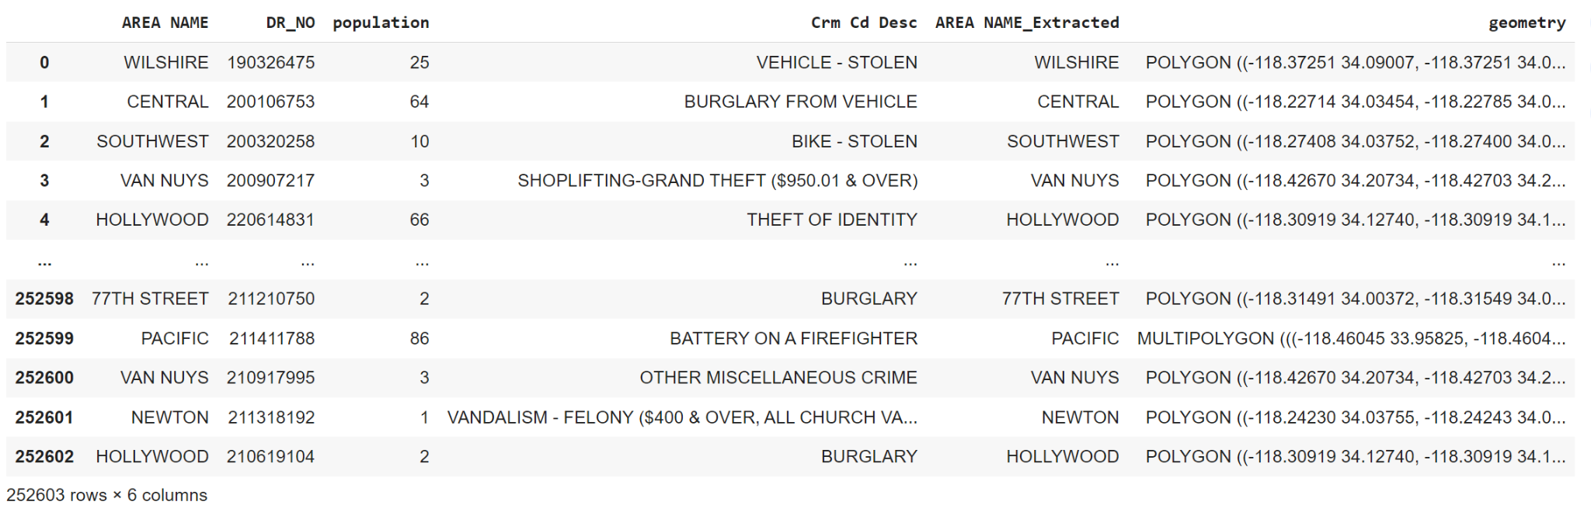
GeoData

Slide 11
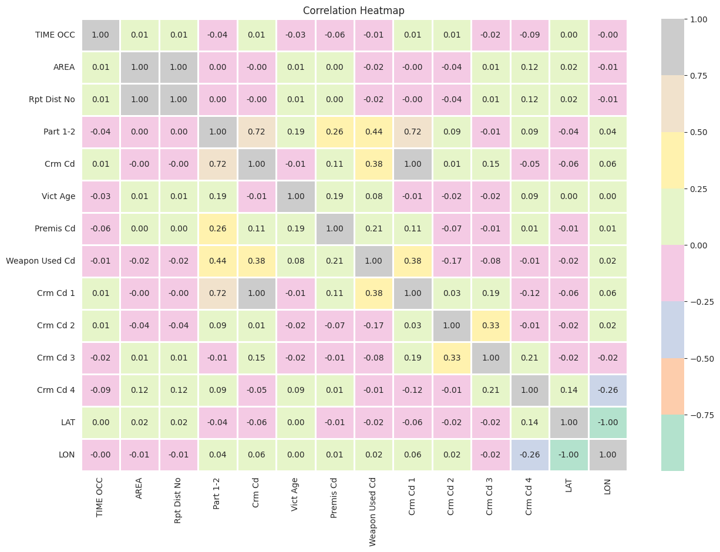
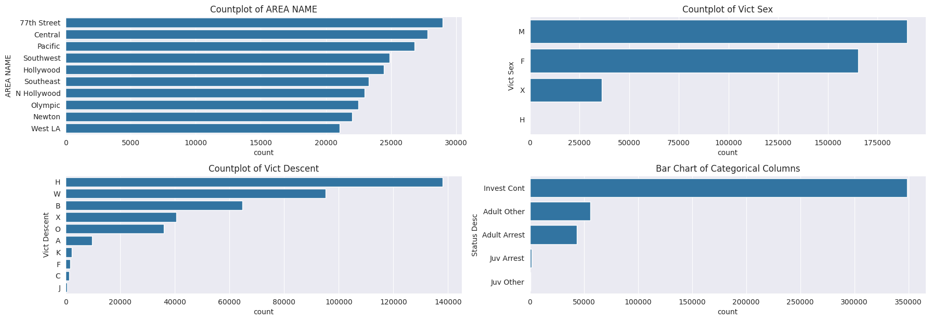
EDA
EXPLORATORY DATA ANALYSIS (EDA)
Donec risus dolor porta venenatis
Pharetra luctus felis
Proin vel tellus in felis volutpat
Molestie nec amet cum sociis
GeeksforGeeks. (n.d.). Exploratory Data Analysis in Python. Retrieved [Date you accessed the information], from https://www.geeksforgeeks.org/exploratory-data-analysis-in-python/

Slide 12
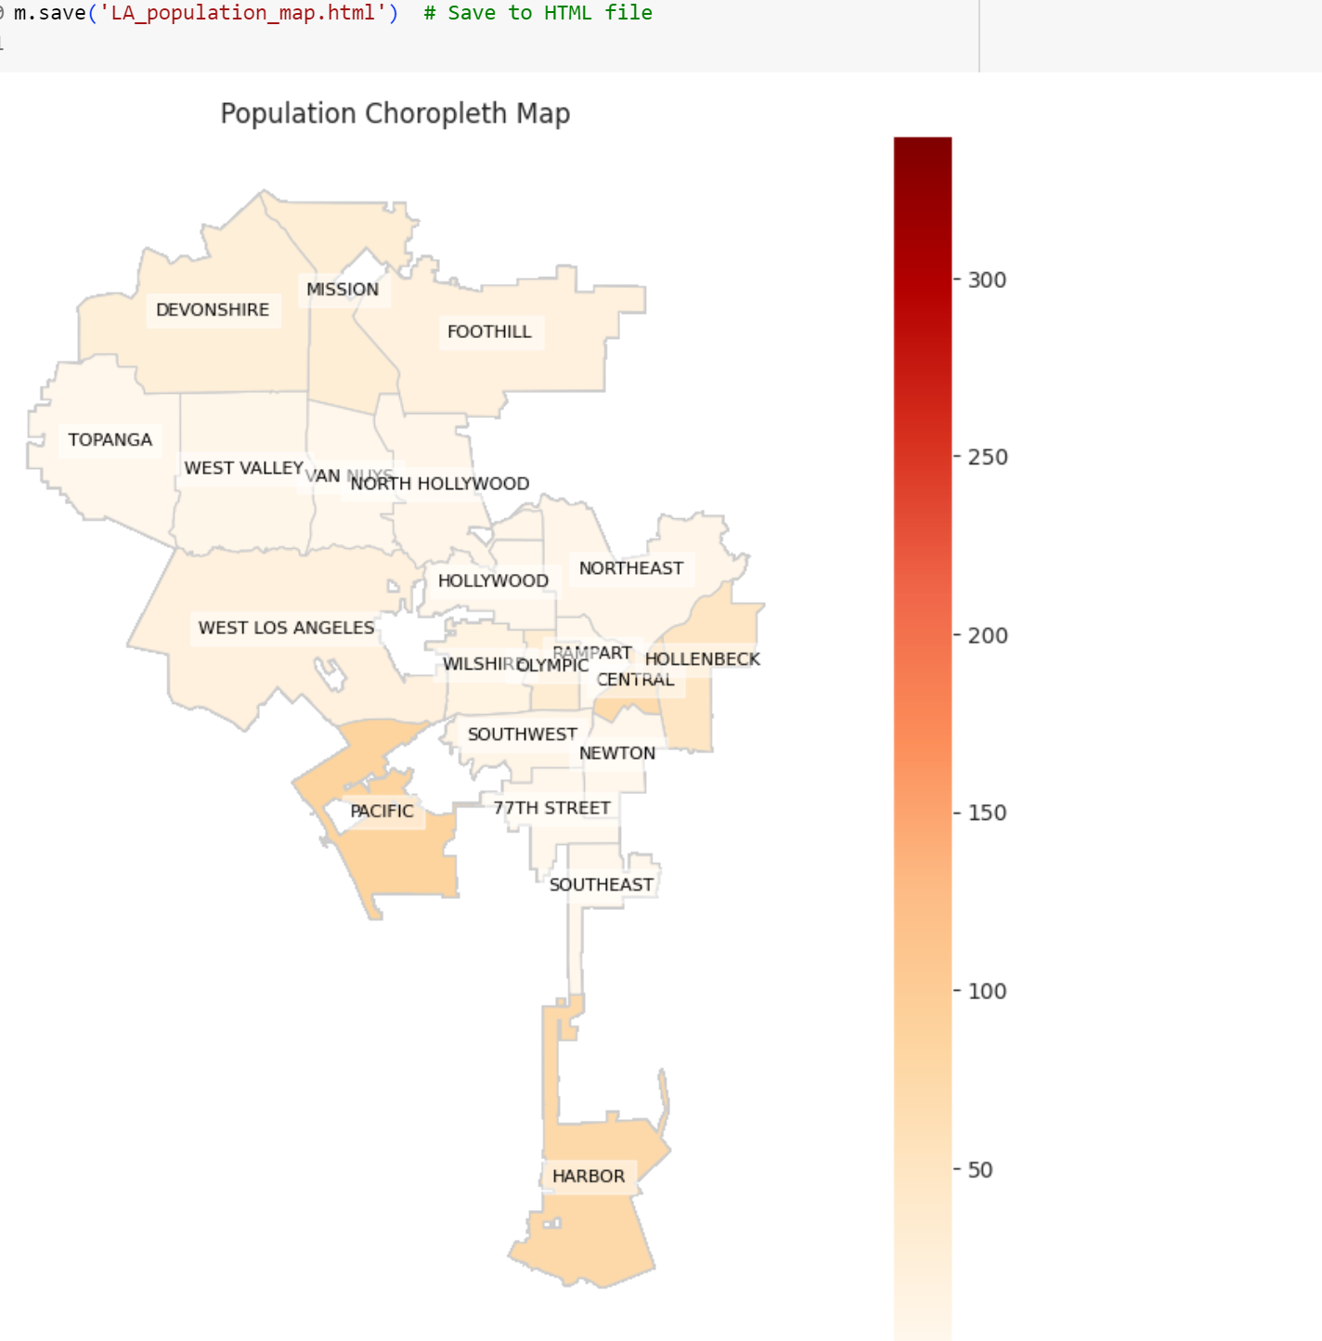
Visualizations

Slide 13
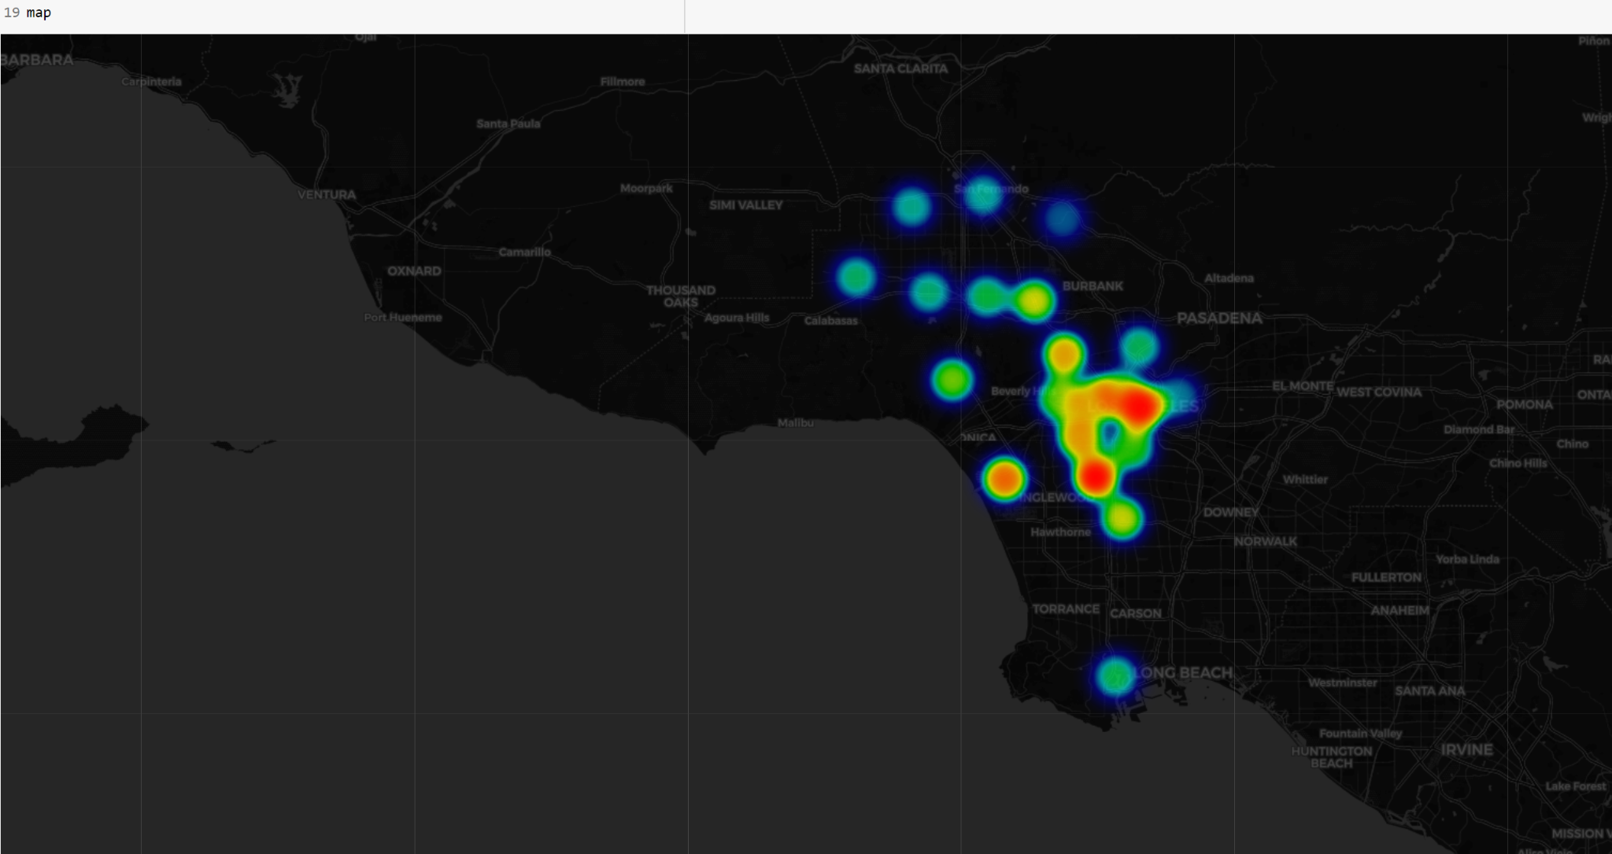
HeatMap

Slide 14
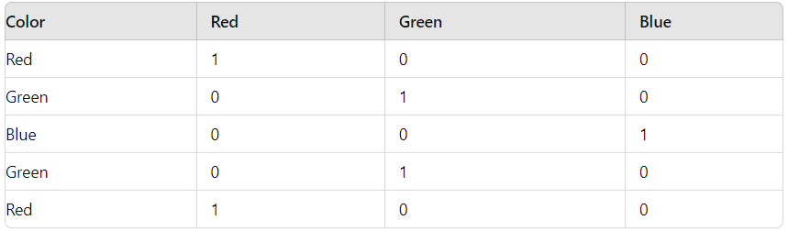
Machine Learning Models
Focused on the following models:
Linear Regression
Decision Tree Regression
Random Forest Regression
Tested Gradient Boosting, Polynomial Regression (2nd Degree and above) but too time consuming to run and poorly performed
Dealt with categorical data using one-hot encoding

Slide 15
Machine Learning Models (cont.)
Data used an 80:20 split (80% of data for training, 20% of data for testing
Decided to only sample 10,000 data points maximum for each crime type for runtime reasons

Slide 16
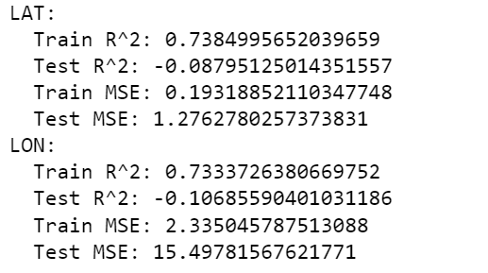
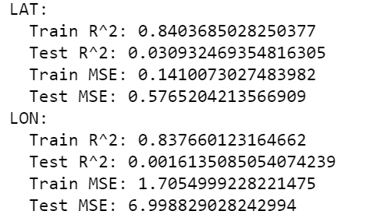
Machine Learning Model Results 1
Crime Type: Theft Of Vehicle
Linear Regression
Random Forest Regression:

Slide 17
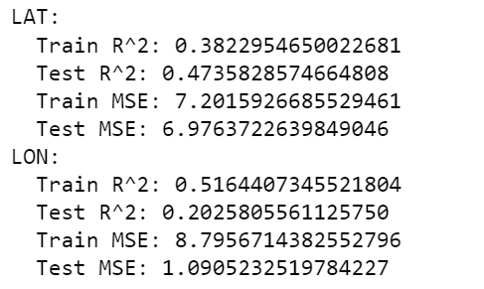
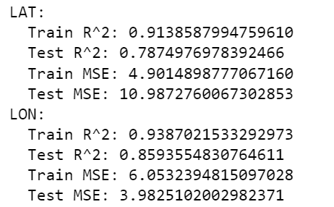
Machine Learning Model Results 2
Crime Type: BATTERY - SIMPLE ASSAULT
Linear Regression
Random Forest Regression:

Slide 18
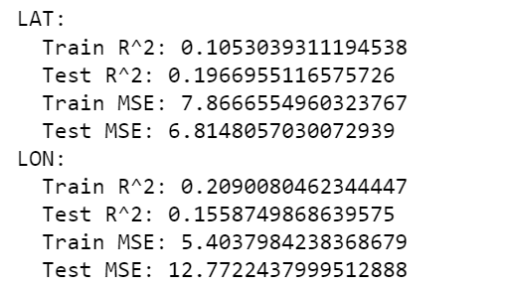
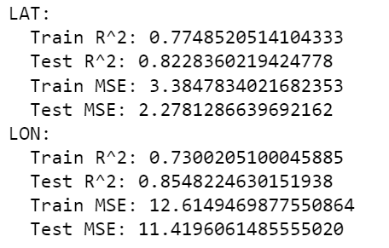
Machine Learning Model Results 3
Crime Type: BURGLARY FROM VEHICLE
Linear Regression
Random Forest Regression:

Slide 19
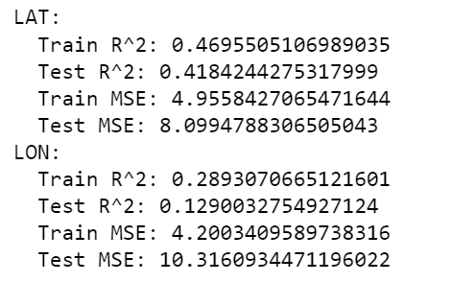
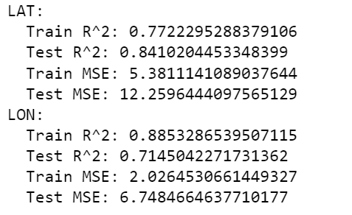
Machine Learning Model Results 4
Crime Type: THEFT OF IDENTITY
Linear Regression
Random Forest Regression:

Slide 20
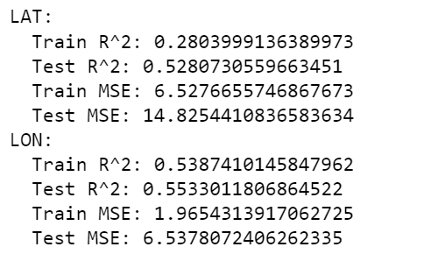
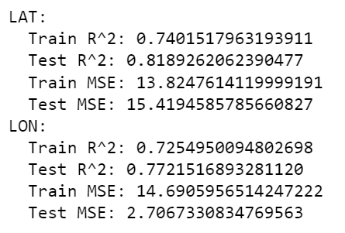
Machine Learning Model Results 5
Crime Type: BURGLARY
Linear Regression
Random Forest Regression:

Slide 21
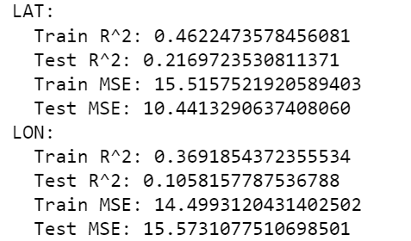
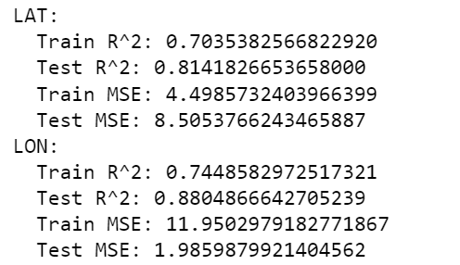
Machine Learning Model Results 6
Crime Type: VANDALISM - FELONY ($400 & OVER, ALL CHURCH VANDALISMS)
Linear Regression
Random Forest Regression:

Slide 22
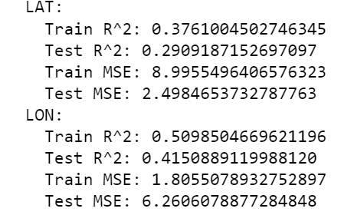
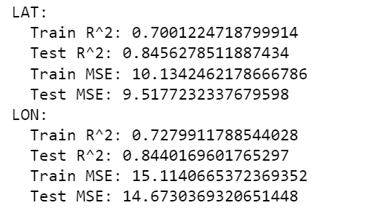
Machine Learning Model Results 7
Crime Type: ASSAULT WITH DEADLY WEAPON, AGGRAVATED ASSAULT
Linear Regression
Random Forest Regression:

Slide 23
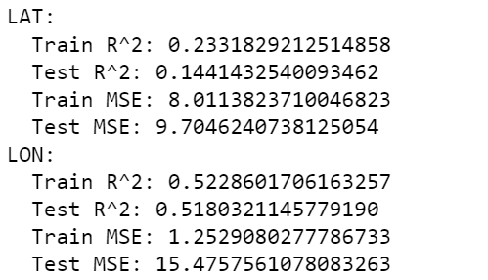
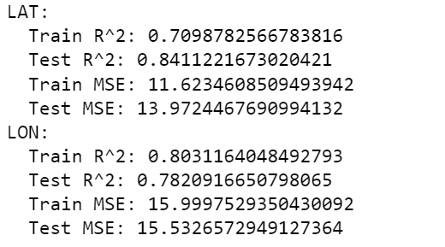
Machine Learning Model Results 9
Crime Type: THEFT PLAIN - PETTY ($950 & UNDER)
Linear Regression
Random Forest Regression:

Slide 24
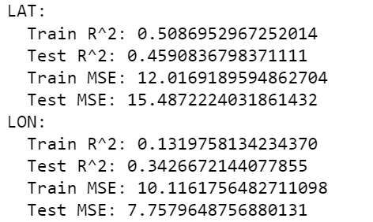
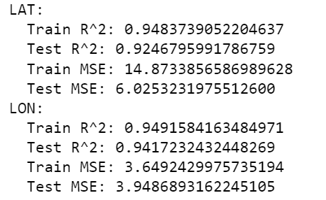
Machine Learning Model Results 10
Crime Type: THEFT PLAIN - PETTY ($950 & UNDER)
Linear Regression
Random Forest Regression:

Slide 25




REFERENCES
City of Los Angeles. (2020). Crime Data from 2020 to Present. LA City Data. https://data.lacity.org/Public-Safety/Crime-Data-from-2020-to-Present/2nrs-mtv8/about_data
Doe, J., & Smith, B. (2012). Crime prediction using machine learning algorithms. Proceedings of the IEEE International Conference on Data Mining, 210-215. https://doi.org/10.1109/ICDM.2012.6298814
GeeksforGeeks. (n.d.). Exploratory Data Analysis in Python. Retrieved [Date you accessed the information], from https://www.geeksforgeeks.org/exploratory-data-analysis-in-python/
GusLovesMath. (2020). Los Angeles Crime Data Quick EDA. Kaggle. https://www.kaggle.com/code/guslovesmath/los-angeles-crime-data-quick-eda
He, J., & Zheng, H. (2021). Prediction of crime rate in urban neighborhoods based on machine learning. Engineering Applications of Artificial Intelligence, 106(104460). https://doi.org/10.1016/j.engappai.2021.104460
Karabo, J. (2023). Application of artificial neural networks in real-time prediction. Journal of Artificial Intelligence, 15(3), 210-225. https://doi.org/10.1007/s12652-023-04530-y
Shah, N. (2021). Understanding crime trends in urban areas. Journal of Urban Crime Analysis, 5(2), 123-135. https://doi.org/10.1186/s42492-021-00075-z
Notes:
NOTE: List key references on the last slide and cite those references, and/or, list a reference at the bottom of the slide that you cite/mention the reference.

Slide 26
Questions?

